Slide 1


Slide 2
TEAM MEMBERS
Sneha.R
Aslin Stephy.D.M
Aswathy.N.S
Babisha.N

Slide 3
TEAM DETAILS
Team No : PNT2022TMID52279
College Name : Stella Mary’s College of Engineering
Department : Computer Science And Engineering

Slide 4
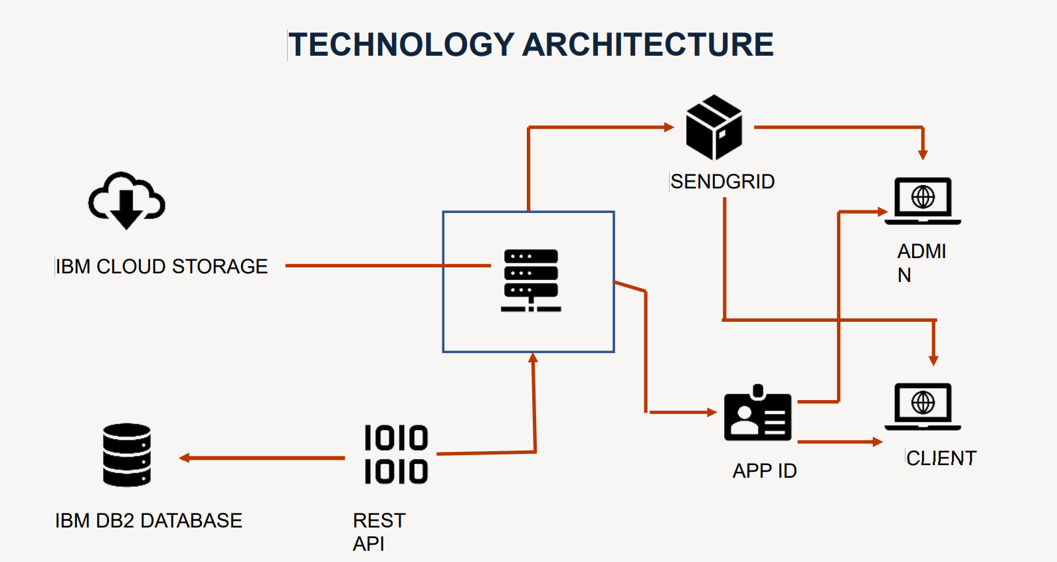

Slide 5
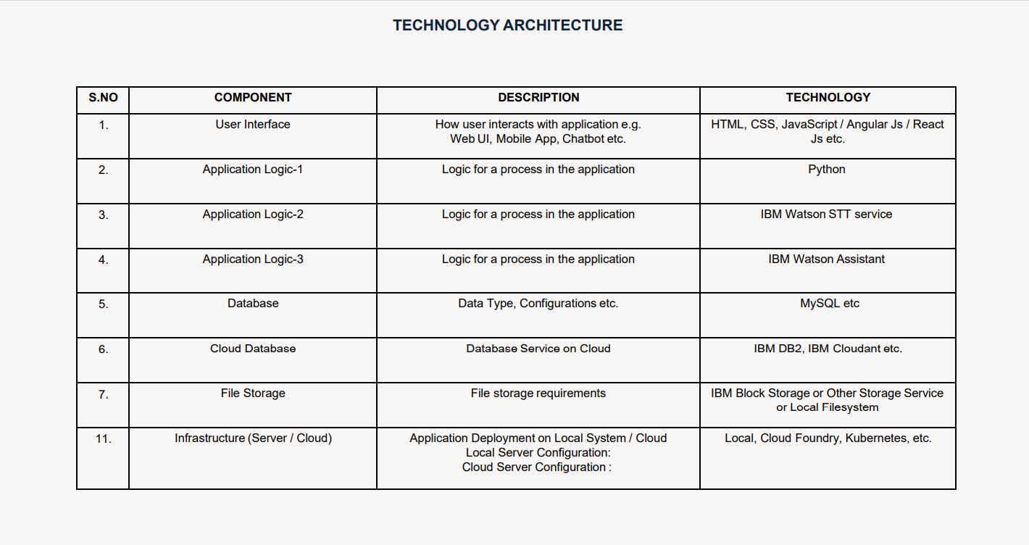

Slide 6
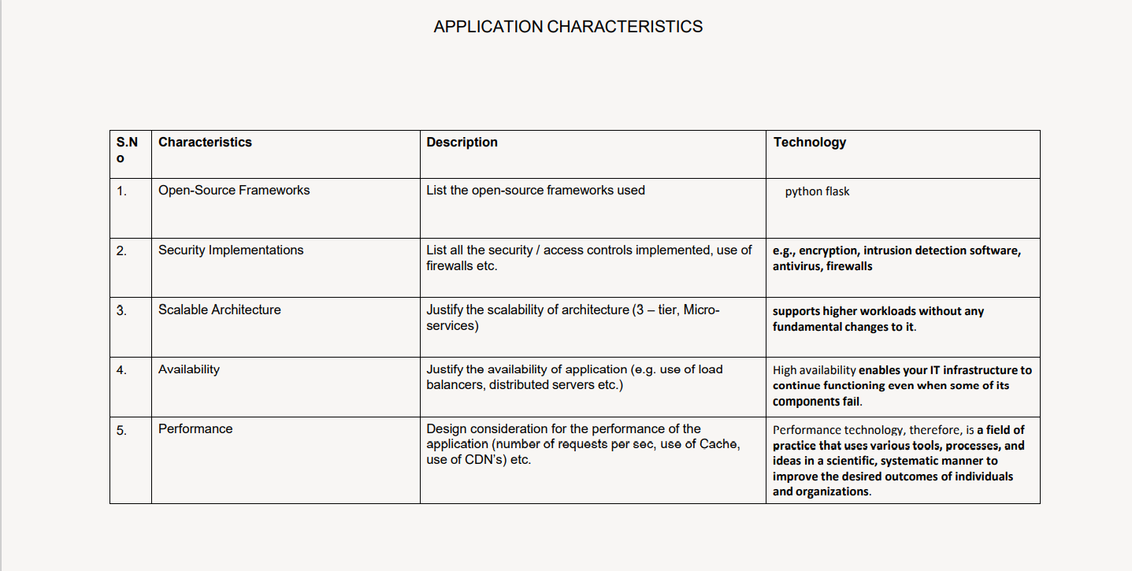

Slide 7


